Slide 1
Lecture -10
Engineering Mechanics
Centroid
and
Centre of Gravity

Slide 2
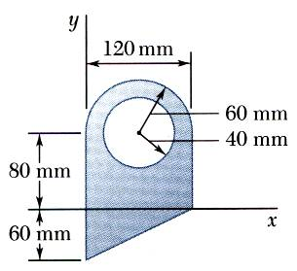
Problem 1: centroid of composite areas

Slide 3
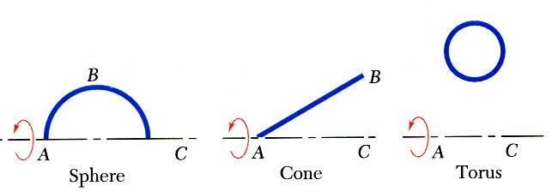
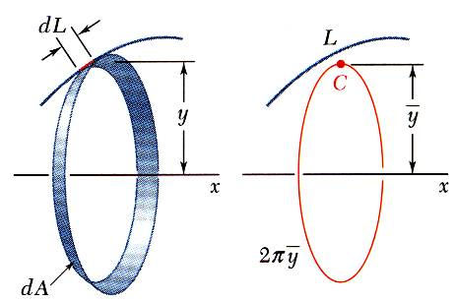
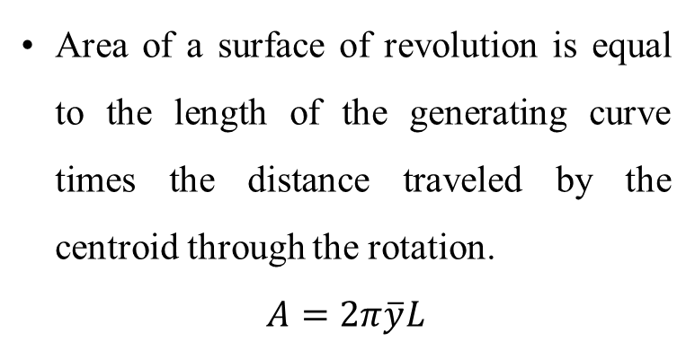
Area: Pappus theorem
Surface of revolution is generated by rotating a plane curve about a fixed axis.
Area of a surface of revolution is equal to the length of the generating curve times the distance traveled by the centroid through the rotation.
$$A=2π\overline{y}L$$

Slide 4
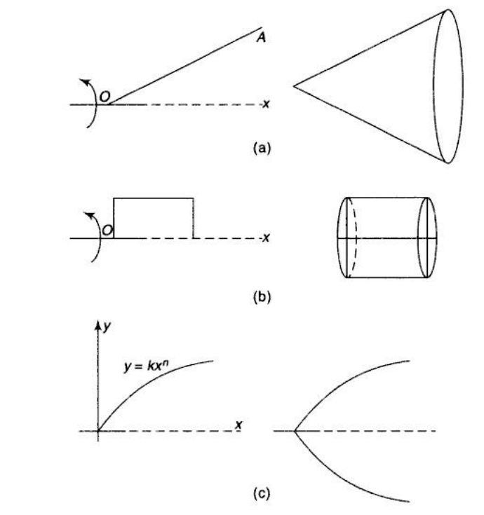
Area: Pappus theorem

Slide 5
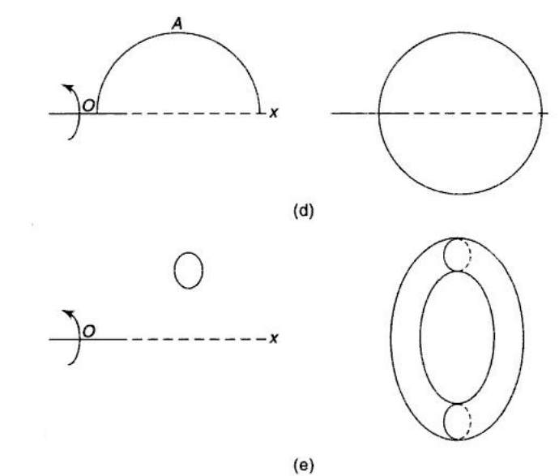
Area: Pappus theorem

Slide 6
Area: Pappus theorem
y
y
r
r
x
x
Using the first theorem of Pappus, calculate the area of the bell shaped shell, which is obtained by rotating a quarter circle arc about x- axis.

Slide 7
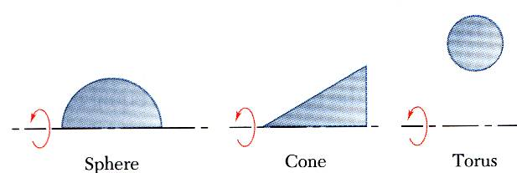
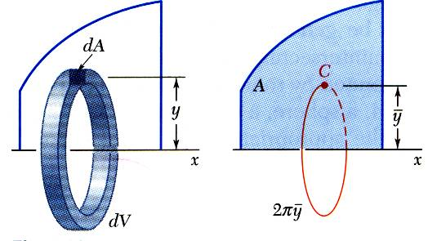
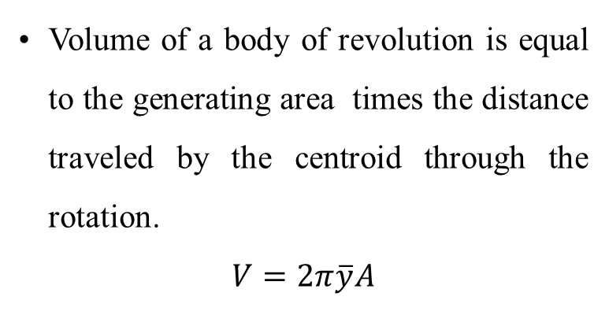
Volume: Pappus theorem
Body of revolution is generated by rotating a plane area about a fixed axis.
Volume of a body of revolution is equal to the generating area times the distance traveled by the centroid through the rotation.
$$V=2π\overline{y}A$$

Slide 8
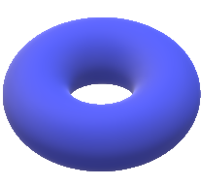
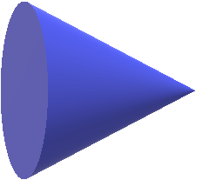

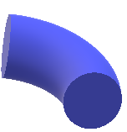
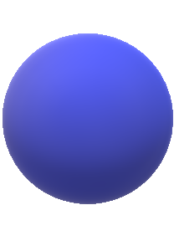
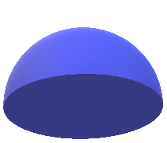
Volume: Pappus theorem

Slide 9
Volume: Pappus theorem
Using the first theorem of Pappus, calculate the surface area of the annular torus formed by revolving the circle about y axis if R=250 mm and r=100 mm.
y
y
x
x
R
r

Slide 10
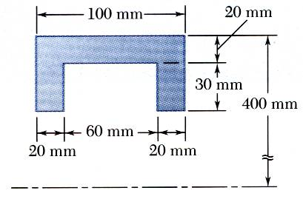
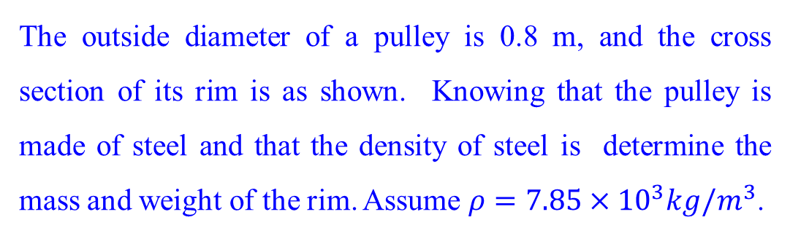
Problem 1: Application of Pappus theorem
The outside diameter of a pulley is 0.8 m, and the cross section of its rim is as shown. Knowing that the pulley is made of steel and that the density of steel is determine the mass and weight of the rim. Assume $ρ=7.85×{10}^{3}kg/m^{3}$.

Slide 11
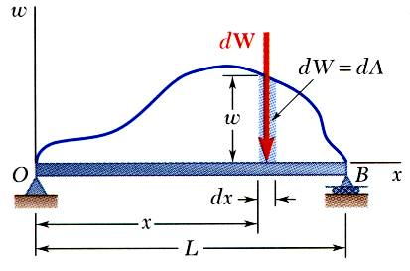
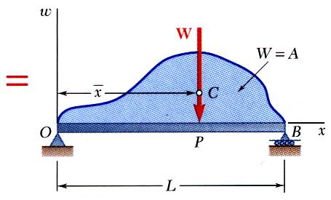
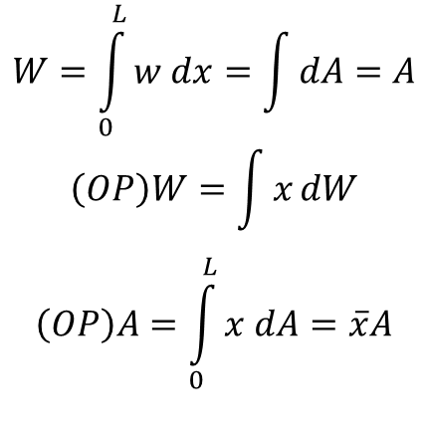
Distributed load on beams
$$W=\int_{0}^{L}{w dx}=\int{dA}=A$$
$$\left(OP\right)W=\int{x}dW$$
$$\left(OP\right)A=\int_{0}^{L}{x dA}=\overline{x}A$$
A distributed load is represented by plotting the load per unit length, w (N/m) . The total load is equal to the area under the load curve.
A distributed load can be replace by a concentrated load with a magnitude equal to the area under the load curve and a line of action passing through the area centroid.

Slide 12
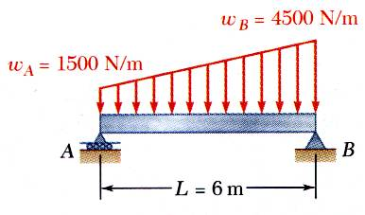
Distributed load on beams
A beam supports a distributed load as shown. Determine the equivalent concentrated load and the reactions at the supports.

Slide 13
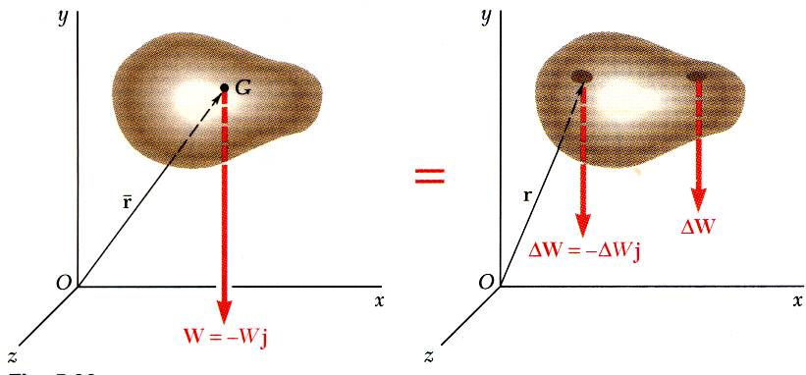
Centre of gravity for 3-D bodies
Center of gravity G
Results are independent of body orientation,
For homogeneous bodies,

Slide 14
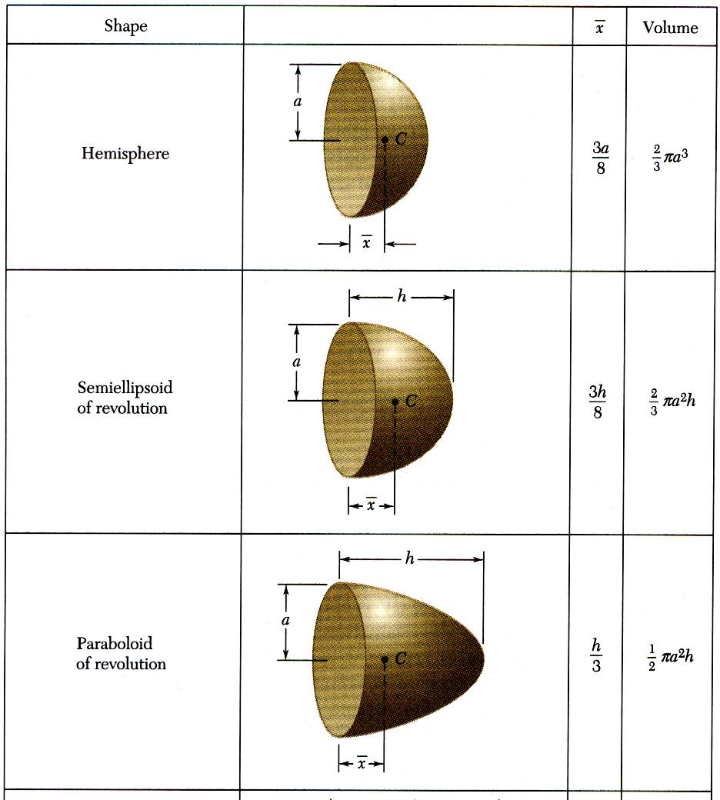
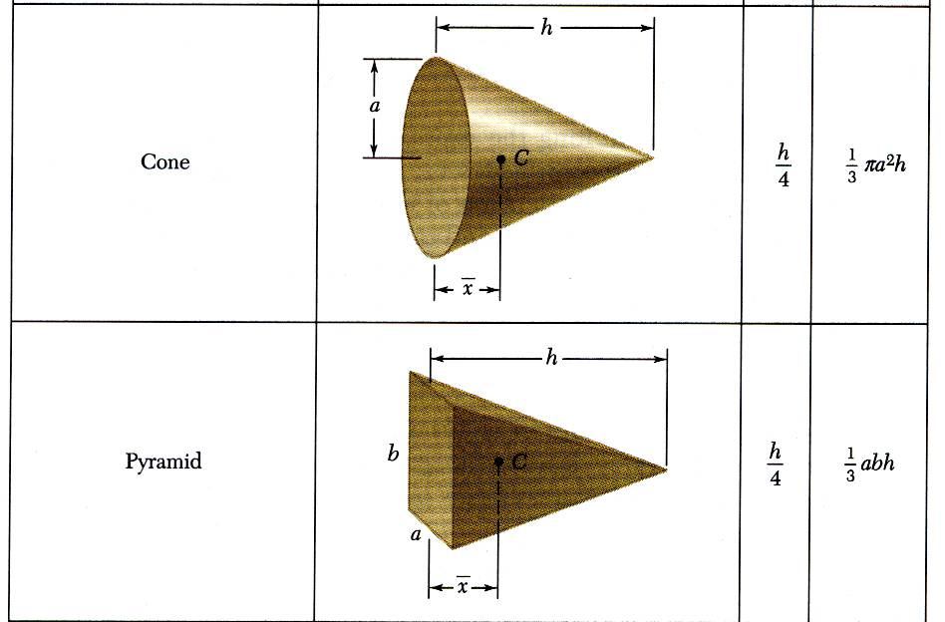
Centre of gravity for 3-D shapes

Slide 15
Centre of gravity for 3-D shapes

Slide 16
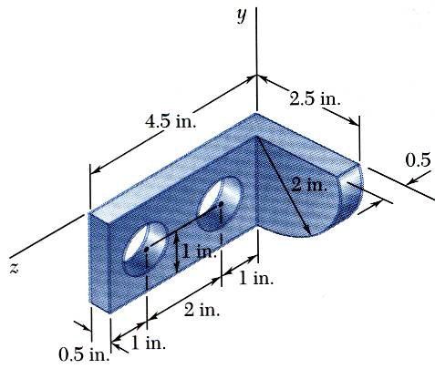
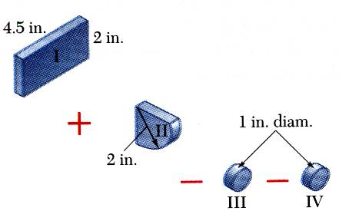
Centre of gravity for composite shapes
Moment of the total weight concentrated at the center of gravity G is equal to the sum of the moments of the weights of the component parts.
For homogeneous bodies,

Slide 17
Acknowledgement
NPTEL lectures on Engineering Mechanics
en.wikipedia.org/wiki
britannica.com
Beer & Johnston, Vector Mechanics for Engineers
Meriam & Kraige, Engineering Mechanics
Problems taken from internet sources
Timoshenko & Young, Engineering Mechanics

